Slide 1
Introduction To Oracle

Slide 2
Introduction to Databases
2
A database is a collection of Data (Information). Examples of databases, which we use in our daily life, is an Attendance Register, Telephone Directory, Muster Rule.
Database Management System(DBMS): A database management system is a collection of programs written to manage a database. That is, it acts as a interface between user and database.
Sahaj Computer Solutions
Introduction to Oracle and Creating Tables

Slide 3
ORACLE
3
Oracle is an Object-Relational Database Management System. It is the leading RDBMS vendor worldwide. Nearly half of RDBMS worldwide market is owned by Oracle.
Sahaj Computer Solutions
Introduction to Oracle and Creating Tables

Slide 4
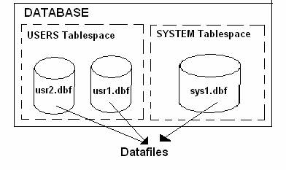
ORACLE DATABASE
4
Every Oracle Database Contains Logical and Physical Structures. Logical Structures are tablespaces, Schema objects, extents and segments. Physical Structures are Datafiles, Redo Log Files, Control File.
A database is divided into logical storage units called tablespaces, which group related logical structures together. Each Tablespace in turn consists of one are more datafiles.
Sahaj Computer Solutions
Introduction to Oracle and Creating Tables

Slide 5
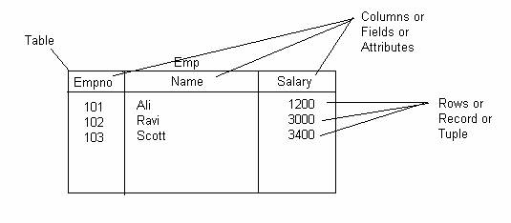
Creating Tables
5
A table is the data structure that holds data in a relational database. A table is composed of rows and columns.
Sahaj Computer Solutions
Introduction to Oracle and Creating Tables

Slide 6
SQL * PLUS
Introduction

Slide 7
SQL*Plus
SQL *Plus is a product of Oracle in which the languages SQL and PL/SQL can be used.
SQL * Plus has its own command language for controlling the product and for formatting the results of the SQL interogations.
SQL * Plus recognizes SQL commands and sends these commands to Oracle server for execution.
sqlplus is equivalent to:
  "sqlcmd" in Microsoft SQL Server
  "psql" in PostgreSQL
  "mysql" in MySQL

Slide 8
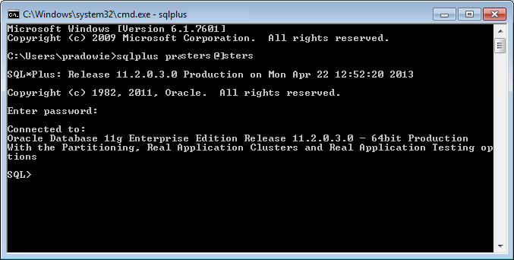
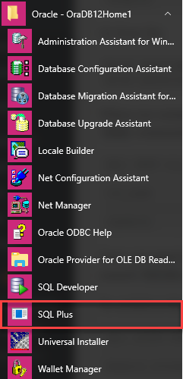
SQL*Plus
Note: If password contain special character like /, #, @, ! etc. then use quotation marks for entering password. E.g. if password is abc/123 then type “abc/123” in password field in above window

Slide 9
Operations you can perform in SQL * Plus
edit, save, load and execute SQL commands and PL/SQL blocks;
list tables structures;
access and transfer data between databases;
implementation of functions for database managing: the users administration, table, operations management of archiving and recovery.
You can use SQL*Plus commands to manipulate SQL commands and PL/SQL blocks and to format and print query results.

Slide 10
SQL | SQL * Plus
It is a language of communication with your Oracle server for accessing data. | Recognize SQL statements and their transfer to your Oracle server.
Is based on the ANSI SQL standard. | Is an interface specifies the Oracle system for executing SQL statements.
Process the data and defines the objects from the database. | Not permit the processing of information in the database.
Does not have a continuation character. | Supports the "-" as the character to break commands on several lines.
The instructions cannot be abbreviated. | Commands may be abbreviated.
Use the functions to perform formatting. | Use the commands for formatting data.
The end of a command is ";" | Requires no end character of a command.

Slide 11
SQL * Plus commands
The most important commands available in SQL * Plus are:
  ACCEPT - used to read a variable input
  DEF (DEFINE) - allow you to declare a variable
  DESC (DESCRIBE) - lists the attributes of objects
  EDIT - opens an editor
  EXIT or QUIT - disconnects the user and SQL * Plus session
  GET - searches for a file in SQL
  LIST - shows the last command executed
  PROMPT - displays a text on the screen
  RUN - lists and runs the command. Same as (/) but / does not list command
  SAVE - save buffer command into a SQL script file
  SET - change environment variables specific to SQL * Plus
  SHOW - displays the environment variables settings in SQL * Plus
  START - run a SQL script

Slide 12
Getting Help
HELP [ INDEX | topic ]
E.g. SQL> HELP ACCEPT
ACCEPT
------
Reads a line of input and stores it in a given substitution variable.
ACC[EPT] variable [NUM[BER] | CHAR | DATE | BINARY_FLOAT | BINARY_DOUBLE]
[FOR[MAT] format] [DEF[AULT] default] [PROMPT text | NOPR[OMPT]] [HIDE]

Slide 13
ACCEPT Command
Reads a line of input and stores it in a given substitution variable.
ACC[EPT] variable [NUM[BER] | CHAR | DATE | BINARY_FLOAT | BINARY_DOUBLE] [FOR[MAT] format] [DEF[AULT] default] [PROMPT text|NOPR[OMPT]] [HIDE]
E.g. To display the prompt "Enter weekly salary: " and place the reply in a NUMBER variable named SALARY with a default of 000.0, enter
  ACCEPT salary NUMBER FORMAT '999.99' DEFAULT '000.0‘ PROMPT 'Enter weekly salary: '

Slide 14
SQL*Plus DEFINE Command
A value can be assigned to a variable using the command DEF [INE] of SQL * PLUS.
Variables can be emptied using UNDEF [INE].
DEFINE Command Syntax:
DEF[INE] [variable]|[variable = text]
DEFINE Command Example:
DEFINE status = 'ACTIVE'
DEFINE my_number
DEFINE my_number = 1234

Slide 15
Substitution variables
Substitution variables allow you to write generic SQL*Plus scripts. They allow you to mark places in a script where you want to substitute values at runtime.
Both ACCEPT and DEFINE can be used to declare substitution variable.
Substitution variables can occur in a condition WHERE, in the ORDER BY clause, in the name of a table.
Syntax
SELECT &column
FROM &table
WHERE &condition
ORDER BY &order ;
Example
SQL > DEFINE name1 = ‘Hira’
SQL > DEFINE name2 = ‘Lal’
SQL > SELECT first_name, age
FROM students
WHERE first_name = ' &name1 '
OR first_name = ' &name2 ';

Slide 16
DESCRIBE
DESC[RIBE] {[schema.]object[@db_link]}
Lists the column definitions for the specified table, view or synonym, or the specifications for the specified function or procedure.
E.g. DESCRIBE customer

Slide 17
GET
GET [FILE] file_name[.ext] [LIST | NOLIST]
Loads an operating system file into the SQL buffer.
If you do not specify a file extension, SQL*Plus assumes the default command-file extension (normally SQL)
E.g. To load a file called YEARENDRPT with the extension SQL into the buffer, enter
GET YEARENDRPT

Slide 18
SAVE
SAV[E] [FILE] file_name[.ext] [CRE[ATE] | REP[LACE] | APP[END]]
Saves the contents of the SQL buffer in an operating system script.
When you SAVE the contents of the SQL buffer, SAVE adds a line containing a slash (/) to the end of the file.
E.g. To save the contents of the buffer in a file named DEPTSALRPT with the extension SQL, enter
SAVE DEPTSALRPT

Slide 19
Execute a SQL script file in SQLPlus
Syntax is
SQL > @{file}
For example, if your file was called script.sql, you'd type the following command at the SQL prompt:
SQL > @script.sql
The above command assumes that the file is in the current directory.
If you need to execute a script file that is not in the current directory, you would type:
SQL > @{path}{file}
For example:
SQL > @/oracle/scripts/script.sql

Slide 20
SET
Sets a system variable to alter the SQL*Plus environment settings for your current session, for example, to:
  customize HTML formatting
  enable or disable the printing of column headings
  set the number of lines per page
  set the display width for data
Syntax
SET system_variable value

Slide 21
Examples
SET ECHO {ON|OFF} lists each command in a script as the command is executed.
SET NULL null_text controls the text displayed for all null values for all columns.
SET NUMF[ORMAT] Sets the default format for displaying numbers.
SET UND[ERLINE] {-|c|ON|OFF} underline the headings of the columns.
SET VER[IFY] {ON|OFF} lists the text of a SQL statement or PL/SQL command before and after replacing substitution variables with values.
SET TAB {ON|OFF} formats white space in terminal output.

Slide 22
Examples
SET TERM[OUT] {ON|OFF} display of output generated by commands executed from a script.
SET TI[ME] {ON|OFF} display the current time.
SET PAGES[IZE] {24|n} Sets the number of lines in each page.
SET SQLC[ASE] {MIX[ED]|LO[WER]|UP[PER]} Converts the case of SQL commands and PL/SQL blocks.
SET SQLP[ROMPT] {SQL>|text} Sets the SQL*Plus command prompt.
SET WRA [P] {OFF | ON} wraps the string within the column bounds

